Slide 1
Data Divers
AI-Driven Music Recommendation Application
Andrew Mark Dale
Abednego njani Ndegwa
Ashutosh Pandey
Darren Saguil
Nikhil Lohar

Slide 2
Scope
Software
Web Application
The user will manually search for a song in a search bar
Upon choosing a song, the website will generate a list of songs, and the user will decide if they want a playlist generated from this list
We acknowledge that a user manually searching for a song isn’t 100% ideal; however, users seeking out this type of web application want personalized recommendations
AI Agent
Recommender System/Unsupervised Clustering
We will build a large clustered model (kNN), a frequent itemset (Apriori), or a Recommender system. We will be running through a variety of models to ensure we take the absolute best approach for the problem at hand
As it stands currently, a kNN approach would seem to be the most ideal. We can pull a certain number of songs (we will allow the user to choose how many they would like), neighbours, and present this to the user

Slide 3
Technology to be Used
Unsupervised approach (AI portion)
Spotify has posted large song datasets that feature millions of songs and their features
We can leverage this by using a clustering approach to find similar songs
Large song datasets are unlabeled with a lot of features, making an unsupervised approach ideal
Python will almost certainly be the language used for development, both for similarity and ample libraries
Various libraries and modules will be considered, including: TensorFlow, Scikit learn, and Lenskit
React
We can build a simple web app using this technology. Similar frameworks will also be considered.
Simple context-based state management
Under Consideration
Spotify API - can get direct data from the user, but the API rates may be expensive or limiting. Due to privacy reasons, some information may also not be available and needs to be authorized (this is beyond the scope of most users)
OpenAI API - can give us powerful LLM outputs for recommendations, but they are still quite expensive without giving us accurate data

Slide 4
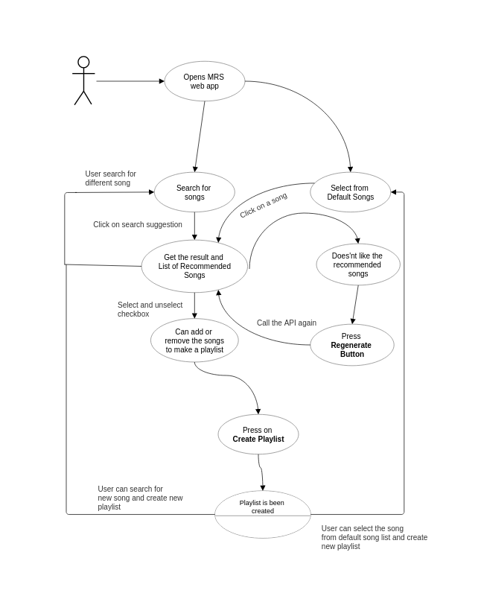
Use Cases
The user opens the MRS web application
The user will search for a song or select a song from the default list provided (currently, we are thinking of the top 10 most popular songs)
The user receives the search song result and the recommended songs in a list format
The user can select, unselect, or regenerate the recommendations
A playlist will be created if the user chooses to generate one. We will provide a link to this playlist on Spotify, and the user can enjoy their new recommendations

